Slide 1
HTML DOM Events

Slide 2
HTML DOM Events
HTML DOM events allow JavaScript to register different event handlers on elements in an HTML document.
Events are normally used in combination with functions, and the function will not be executed before the event occurs (such as when a user clicks a button).
Events are a part of the Document Object Model (DOM) Level 3 and every HTML element have a certain set of events which can trigger JavaScript Code.

Slide 3
Mouse Events
Property | Description
onclick | The event occurs when the user clicks on an element
ondblclick | The event occurs when the user double-clicks on an element
onmousedown | The event occurs when a user presses a mouse button over an element
onmousemove | The event occurs when the pointer is moving while it is over an element
onmouseover | The event occurs when the pointer is moved onto an element
onmouseout | The event occurs when a user moves the mouse pointer out of an element
onmouseup | The event occurs when a user releases a mouse button over an element

Slide 4
onclick
This is the most frequently used event type which occurs when a user clicks mouse left button. You can put your validation, warning etc against this event type.
function sayHello() { alert("Hello World") }
<input type="button" onclick="sayHello()" value="Say Hello" />
View It

Slide 5
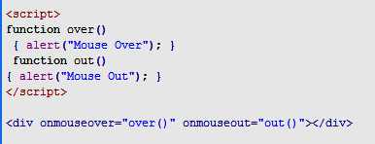
onmouseover and onmouseout:
These two event types will help you to create nice effects with images or even with text as well. The onmouseover event occurs when you bring your mouse over any element and theonmouseout occurs when you take your mouse out from that element.
View It

Slide 6
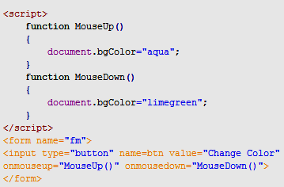
onmouseup/onmousedown
View It

